Slide 1
Simple use cases - Camara
Net Maui

Slide 2
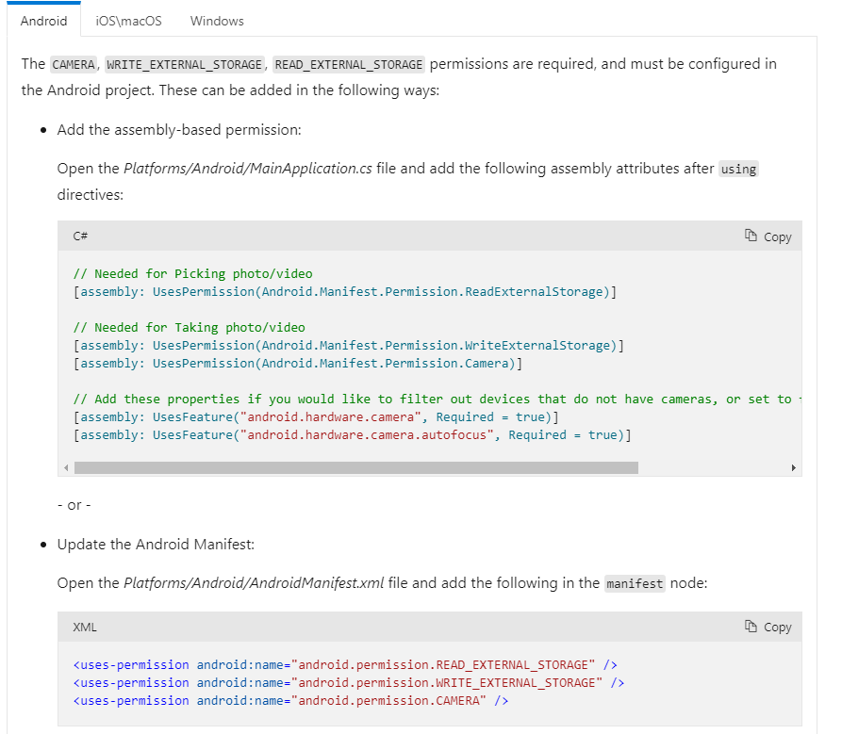
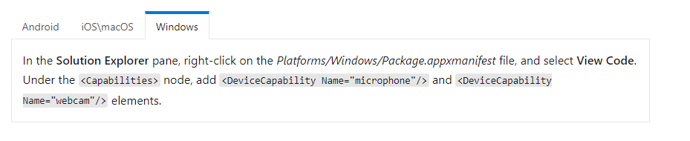
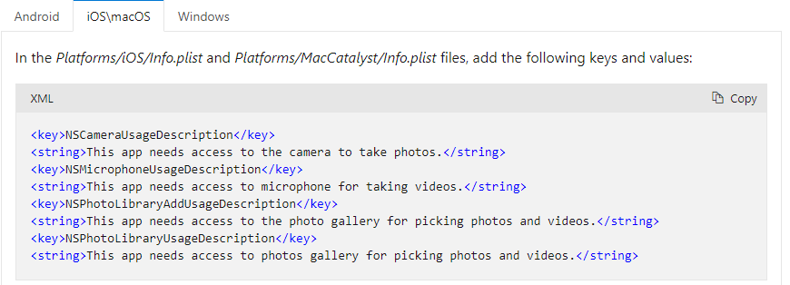
Media picker
To access the media picker functionality, the following platform-specific setup is required.

Slide 3
Using media picker
PickPhotoAsync - Opens the media browser to select a photo.
CapturePhotoAsync - Opens the camera to take a photo.
PickVideoAsync - Opens the media browser to select a video.
CaptureVideoAsync - Opens the camera to take a video.
All return a FileResult, which can be used to get the file's location or read it.

Slide 4
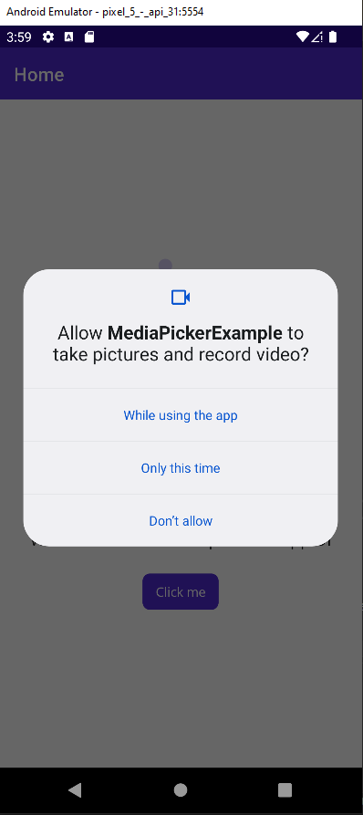
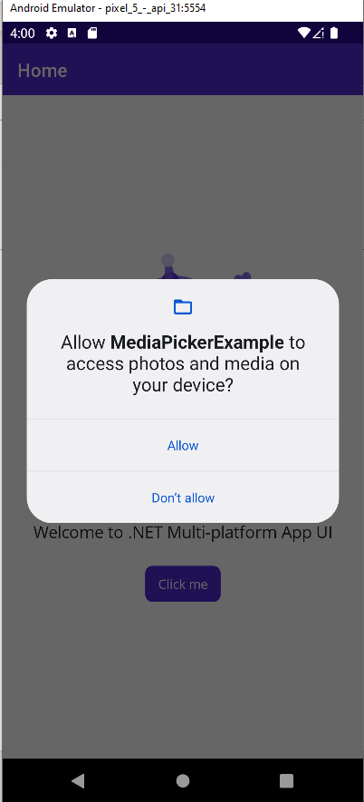
Example Android

Slide 5
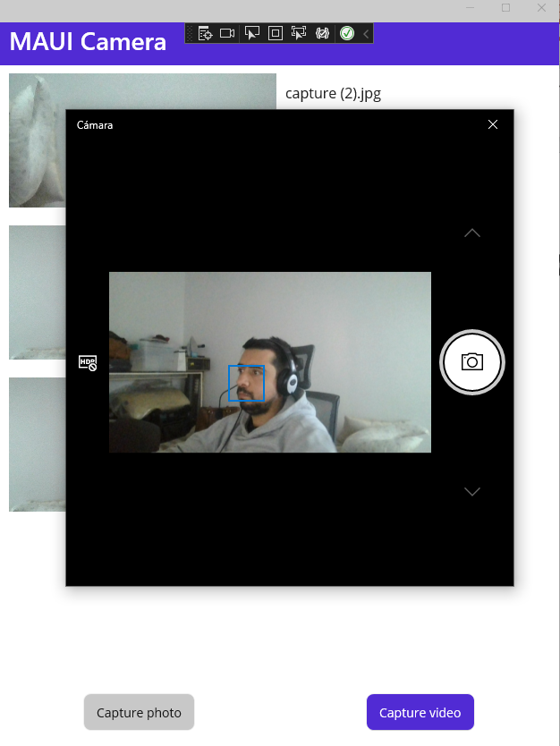
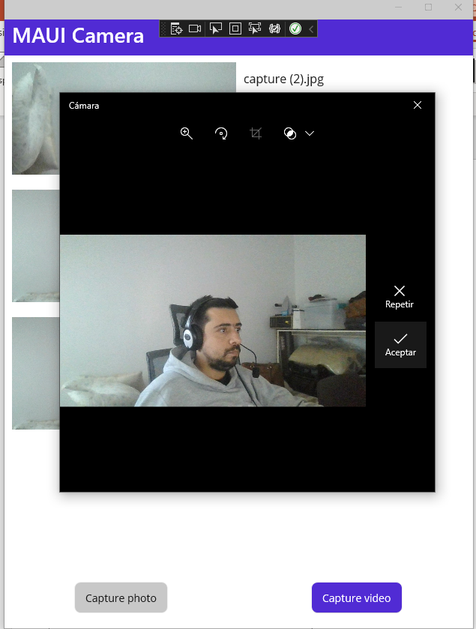
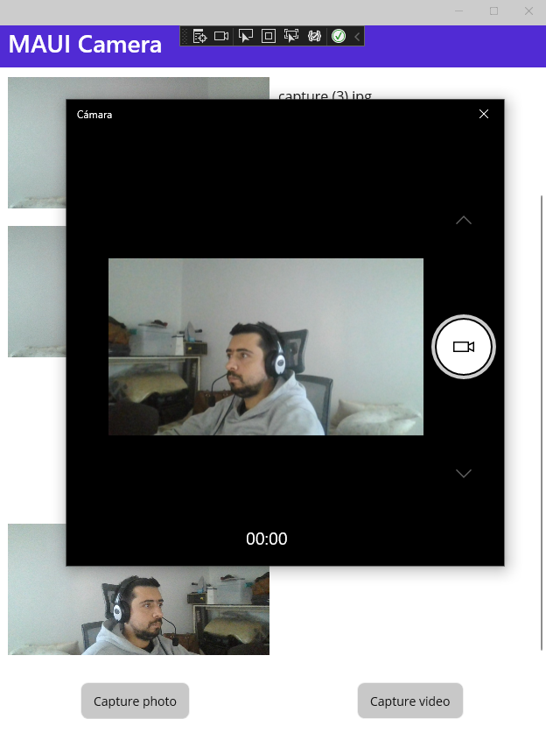
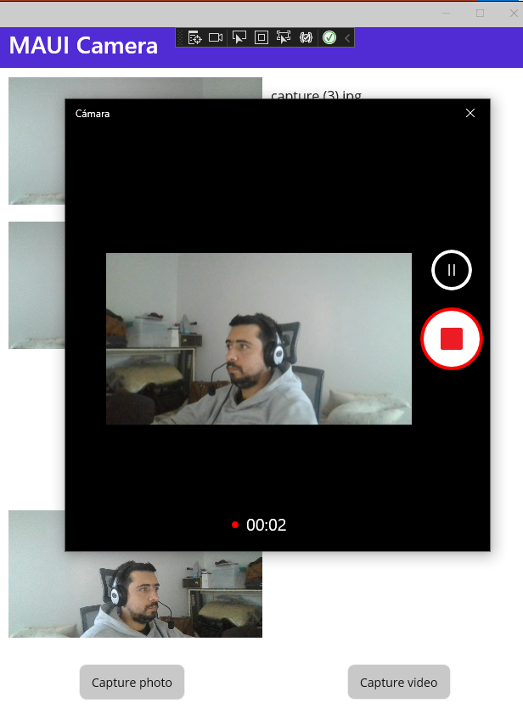
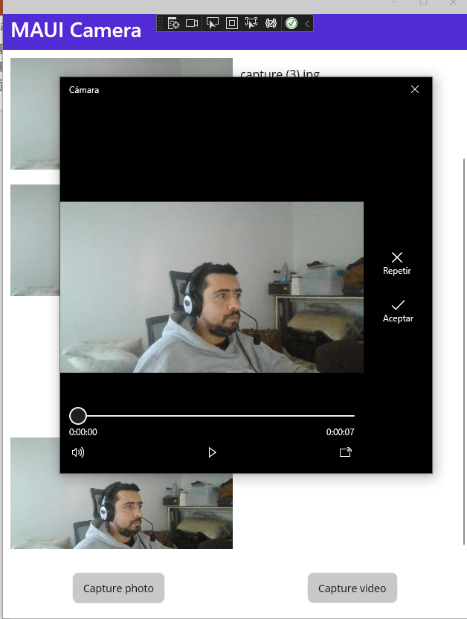
Example Windows

